Slide 1
Economic Impacts of Broadband and What Local Governments can do
Eric Biltonen, Community, Natural Resource, and Economic Development

Slide 2
Socio-Economic Impact of Broadband
“Broadband has steadily shifted from an optional amenity to a core utility for households, businesses and community institutions. Today, broadband is taking its place alongside water, sewer and electricity as essential infrastructure for communities.”
- Broadband Opportunity Council Report and Recommendations, August 20, 2015

Slide 3
What is Broadband?
Bandwidth: The amount of data that can travel in a given time (dependent on the size of the “pipe” data travels)
Broadband: Federal Communication Commission (FCC) definition (for residential service): 25 Mbps Down/3 Mbps Up
Adequate broadband: Service that is always on, uninterrupted, and has sufficient capacity to meet needs of all users.
Notes:
Andy:
FCC Definition:
Proposed change for this year could be as high as 25 Mbps download
This last definition is the one that I have been using for more than ten years. It best describes what is needed and our needs are rapidly changing. We will come back to a brief discussion of the demand survey and broadband assessment tool that helps us determine what is needed.

Slide 4
Common Wired Technologies
Fiber-optic cable
Performance: High
Reliability: High
Cost: High
Maintenance: Low
Digital Subscriber Line
Performance: Moderate
Reliability: Moderate/High
Cost: Low (Compared to Fiber)
Maintenance: Moderate
Cable
Performance: High
Reliability: Moderate
Cost: Varies (Whether new or existing HFC)
Maintenance: Moderate

Slide 5
Common Wireless Technologies
Wi-Fi
Performance: Varies, Limited Range
Reliability: High
Cost: Low
Maintenance: Low
Wireless
3G, 4G, LTE
Performance: Moderate to Very High
Reliability: Moderate
Cost: Low/Moderate
Comments: 4G LTE not available everywhere, limited range, and data limits
Wi-Max
Performance: Moderate/High
Reliability: Moderate
Cost: Moderate
Comments: Commonly Used by WISPs, Backhaul, or Redundant Service and May Require Licensing

Slide 6
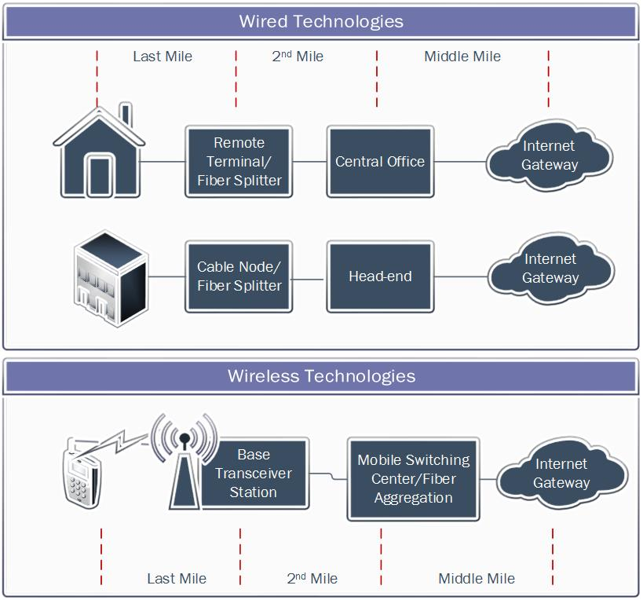
Wired or Wireless?
“You have to have them both…”
Notes:
Jill:
Defy the myth: Wireless does not stand alone—it can’t take over the world and be the only solution; in other words, you can’t have wireless without a wired connection. Ya need em both!
So, How Did We get and how do we evolve so all communities are connected?

Slide 7
Socio-Economic Impact of Broadband
“Access to high-speed broadband is no longer a luxury; it is a necessity for American families, businesses, and consumers. Affordable, reliable access to high-speed broadband is critical to U.S. economic growth and competitiveness.” – President Barack Obama
“[T]hey asked, ‘How many homes?’ When we said ‘five,’ they literally burst out laughing. ‘In Woodbury, it’d be 200 and we’d be talking to you,’ they said. ‘But we are not going to build out Afton.’” – Star Tribune, October 24, 2015

Slide 8
Socio-Economic Benefits of Broadband
What are the range of benefits of broadband
Jobs and Income
Business and Economics
Education
Home Values
Public Services and Amenities

Slide 9
Broadband Impacts: Jobs and Income
Broadband access: gaining 4Mbps can increase household income by $2,100 (1)
Broadband speed: Upgrading from 0.5 Mbps to 4 Mbps can increase income by over $300 month (1)
Broadband Speed boosts personal productivity and allows more flexible work arrangements (1)
Enhances workforce participation, advanced certifications (5)
Investments in broadband infrastructure creates jobs (100,000 jobs/ $5 billion; 498,000 jobs/ $10 billion)(300,000 jobs for every 1% increase in BB penetration) (7% increase in bb adoption could create or save 50,748 new jobs per year in Wisconsin, $1.86 billion in income growth) (5)

Slide 10
Broadband Impacts: Jobs and Income
Online talent platforms could add $2.7 trillion to global GDP and increase global employment by 72 million FTEs (6)
Voluntary job changes are associated with higher wages. Broadband creates a more dynamic job market (6)
Increase labor participation and hours worked, shortening job searches and enabling matches, raise productivity – annual global benefit of $625 billion (6)
Create transparency around the demand for skills enabling people to make better choices in education and job searches (6)

Slide 11
Broadband Impacts: Business & Economics
Doubling broadband speeds and add 0.3% to GDP growth (1)
Increased business innovation and productivity (1)
More potential for home based businesses as a replacement or complement to other job (1)
WSJ reports towns with less access are falling behind economically (4)
Unreliable internet can derail businesses (4)
Helps business expand market reach and customer bases, especially small businesses and startups (5)
Survey of Tech Executives: 82% ranked broadband as very or somewhat important (5)

Slide 12
Broadband Impacts: Business & Economics
Enhances ability for tech related startups to emerge (5)
Broadband has positive impact on industry clusters with a more developed supply of broadband infrastructure associated with a higher level of entrepreneurial activity (7)
Additionally, proximity to educational institutional also contributed significantly to positive increases in entrepreneurial activity (7)
Investments in Broadband infrastructure strengthen regional economies by improving skills, competitiveness, and service delivery (8)
Broadband speed matters – studies confirm impact on economic growth in developed and less developed countries. More important in countries with lower incomes. (9)

Slide 13
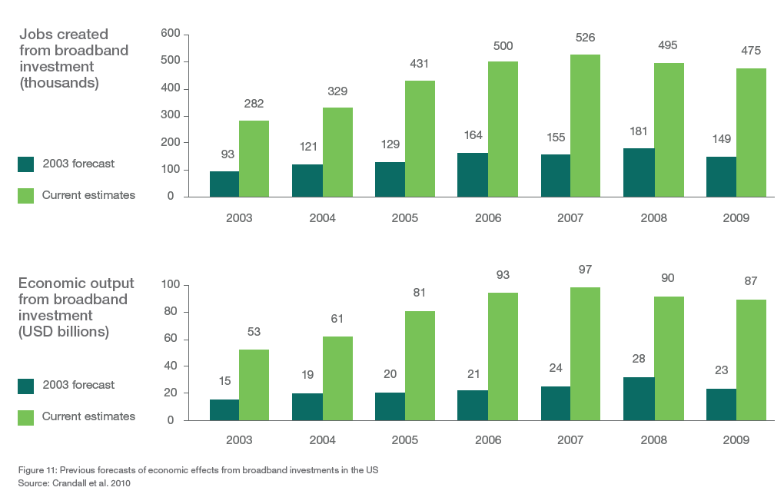
Socio-Economic Impacts of Broadband

Slide 14
Broadband Impacts: Education
Student without access may struggle to complete homework assignments (4)
Provides access to high education and continued education (distance learning)(5)
Enhances workforce advanced certifications (5)

Slide 15
Broadband Impacts: Home Values
Fiber to the home (FTTH) raises value of single family homes by $5,000 - $6,000 on a home values at $300K (July 2014, Broadband Communities Magazine)(2)
Renter rate broadband has almost as important as a washer and dryer ➔ An apartment with broadband could yield almost $1,000 extra in rent from lower vacancies, not including savings from administrative costs of finding a new tenants. (2)
Single family homes with ability to upgrade to 1 Gbps have a price that is 1.8% more than similar homes where upgrade is limited to 100Mbps. (exp. 1.8% X $300,000 = $5,400)(3)
Homes with fiber have a price that is 1.3% more than similar homes without fiber (exp. 1.3% X $300,000 = $3,900)(3)
Study by University of Colorado and Carnegie Mellon University find fiber connections can add $5,437 to price of a $175,000 home (half the value of a bathroom).(4)
2014 Study by University of Wisconsin found access to internet could add $11,815 to the value of a $439,000 vacation home in Door County. (4)

Slide 16
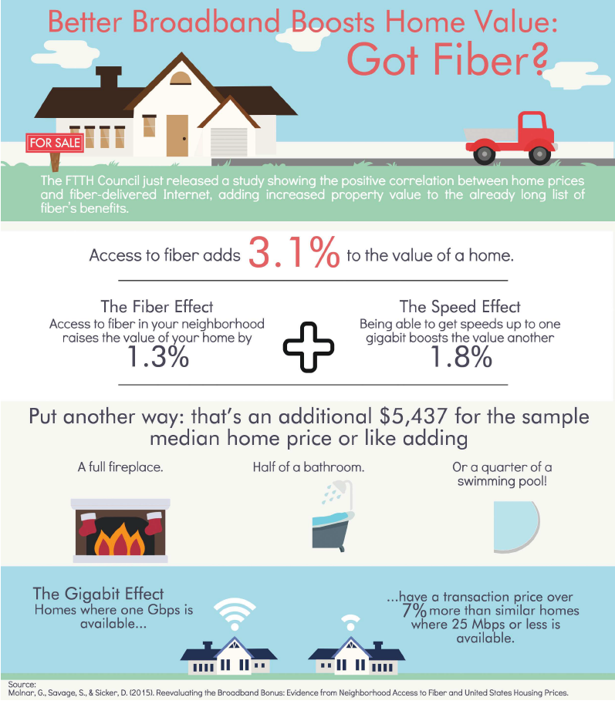
Broadband Impacts: Home Values

Slide 17
Broadband Impacts: Public Services
Allows people to be more informed, better educated, and socially and culturally enriched ➔ Faster career path (1)
2014 report by the American Planning Association found Millennials ranks broadband 3rd when asked to identify high priorities for metro urban areas – just behind safe streets and affordable housing (2)
Is central to healthcare (records, access to expertise)(5)
Improved response to emergencies (5)
Improved service deliver including: service delivery: Education, health care, public safety and emergency response, citizen and social services, economic and workforce development, and rural and regional development (8)

Slide 18
Socio-Economic Impacts of Broadband
Broadband speed matters – studies confirm impact on economic growth in developed and less developed countries. More important in countries with lower incomes.
Benefits of faster speed:
Significantly faster file transfers, both sending and receiving
Enabling video streaming applications
High quality real-time communication
Enabling users to use many applications at the same time
Source: Kongaut, Rohman, and Bohlin (2014) The Economic Impact of Broadband Speed: Comparing between Higher and Lower Income Countries

Slide 19
Socio-Economic Impacts of Broadband: Some Headlines
Connecting can be paid for…but at a cost, and not always:
“Man builds house, then finds out cable internet will cost $100,000”
“Want fiber internet? That’ll be $383,500, ISP tells farm owner”
“New homeowner selling house because he can’t get Comcast Internet”
“One man’s failed quest to buy wired internet from TWC or Verizon”
“Disconnect: Money can’t buy you broadband in wealthy exurbs”

Slide 20
St Croix County EDC’s Broadband Committee
St Croix County EDC’s Broadband Committee was formed to assist in efforts to increase broadband access, reliability, and speeds throughout St Croix County, including consumer, commercial, agricultural and organizational users, from a perspective of economic development.
April 14, 2015 – Presentation on Broadband for St Croix EDC
May 12, 2015 – EDC Created a Broadband Committee for Saint Croix County
June 3, 2015 – Broadband Boot Camp in Eau Claire
Nov-Dec 2015 – Administered a survey on broadband access and use in St Croix
Early 2016 – Initiate phase 2 of survey and organize to respond to grant opportunities

Slide 21
The Phase 1 Survey

Slide 22
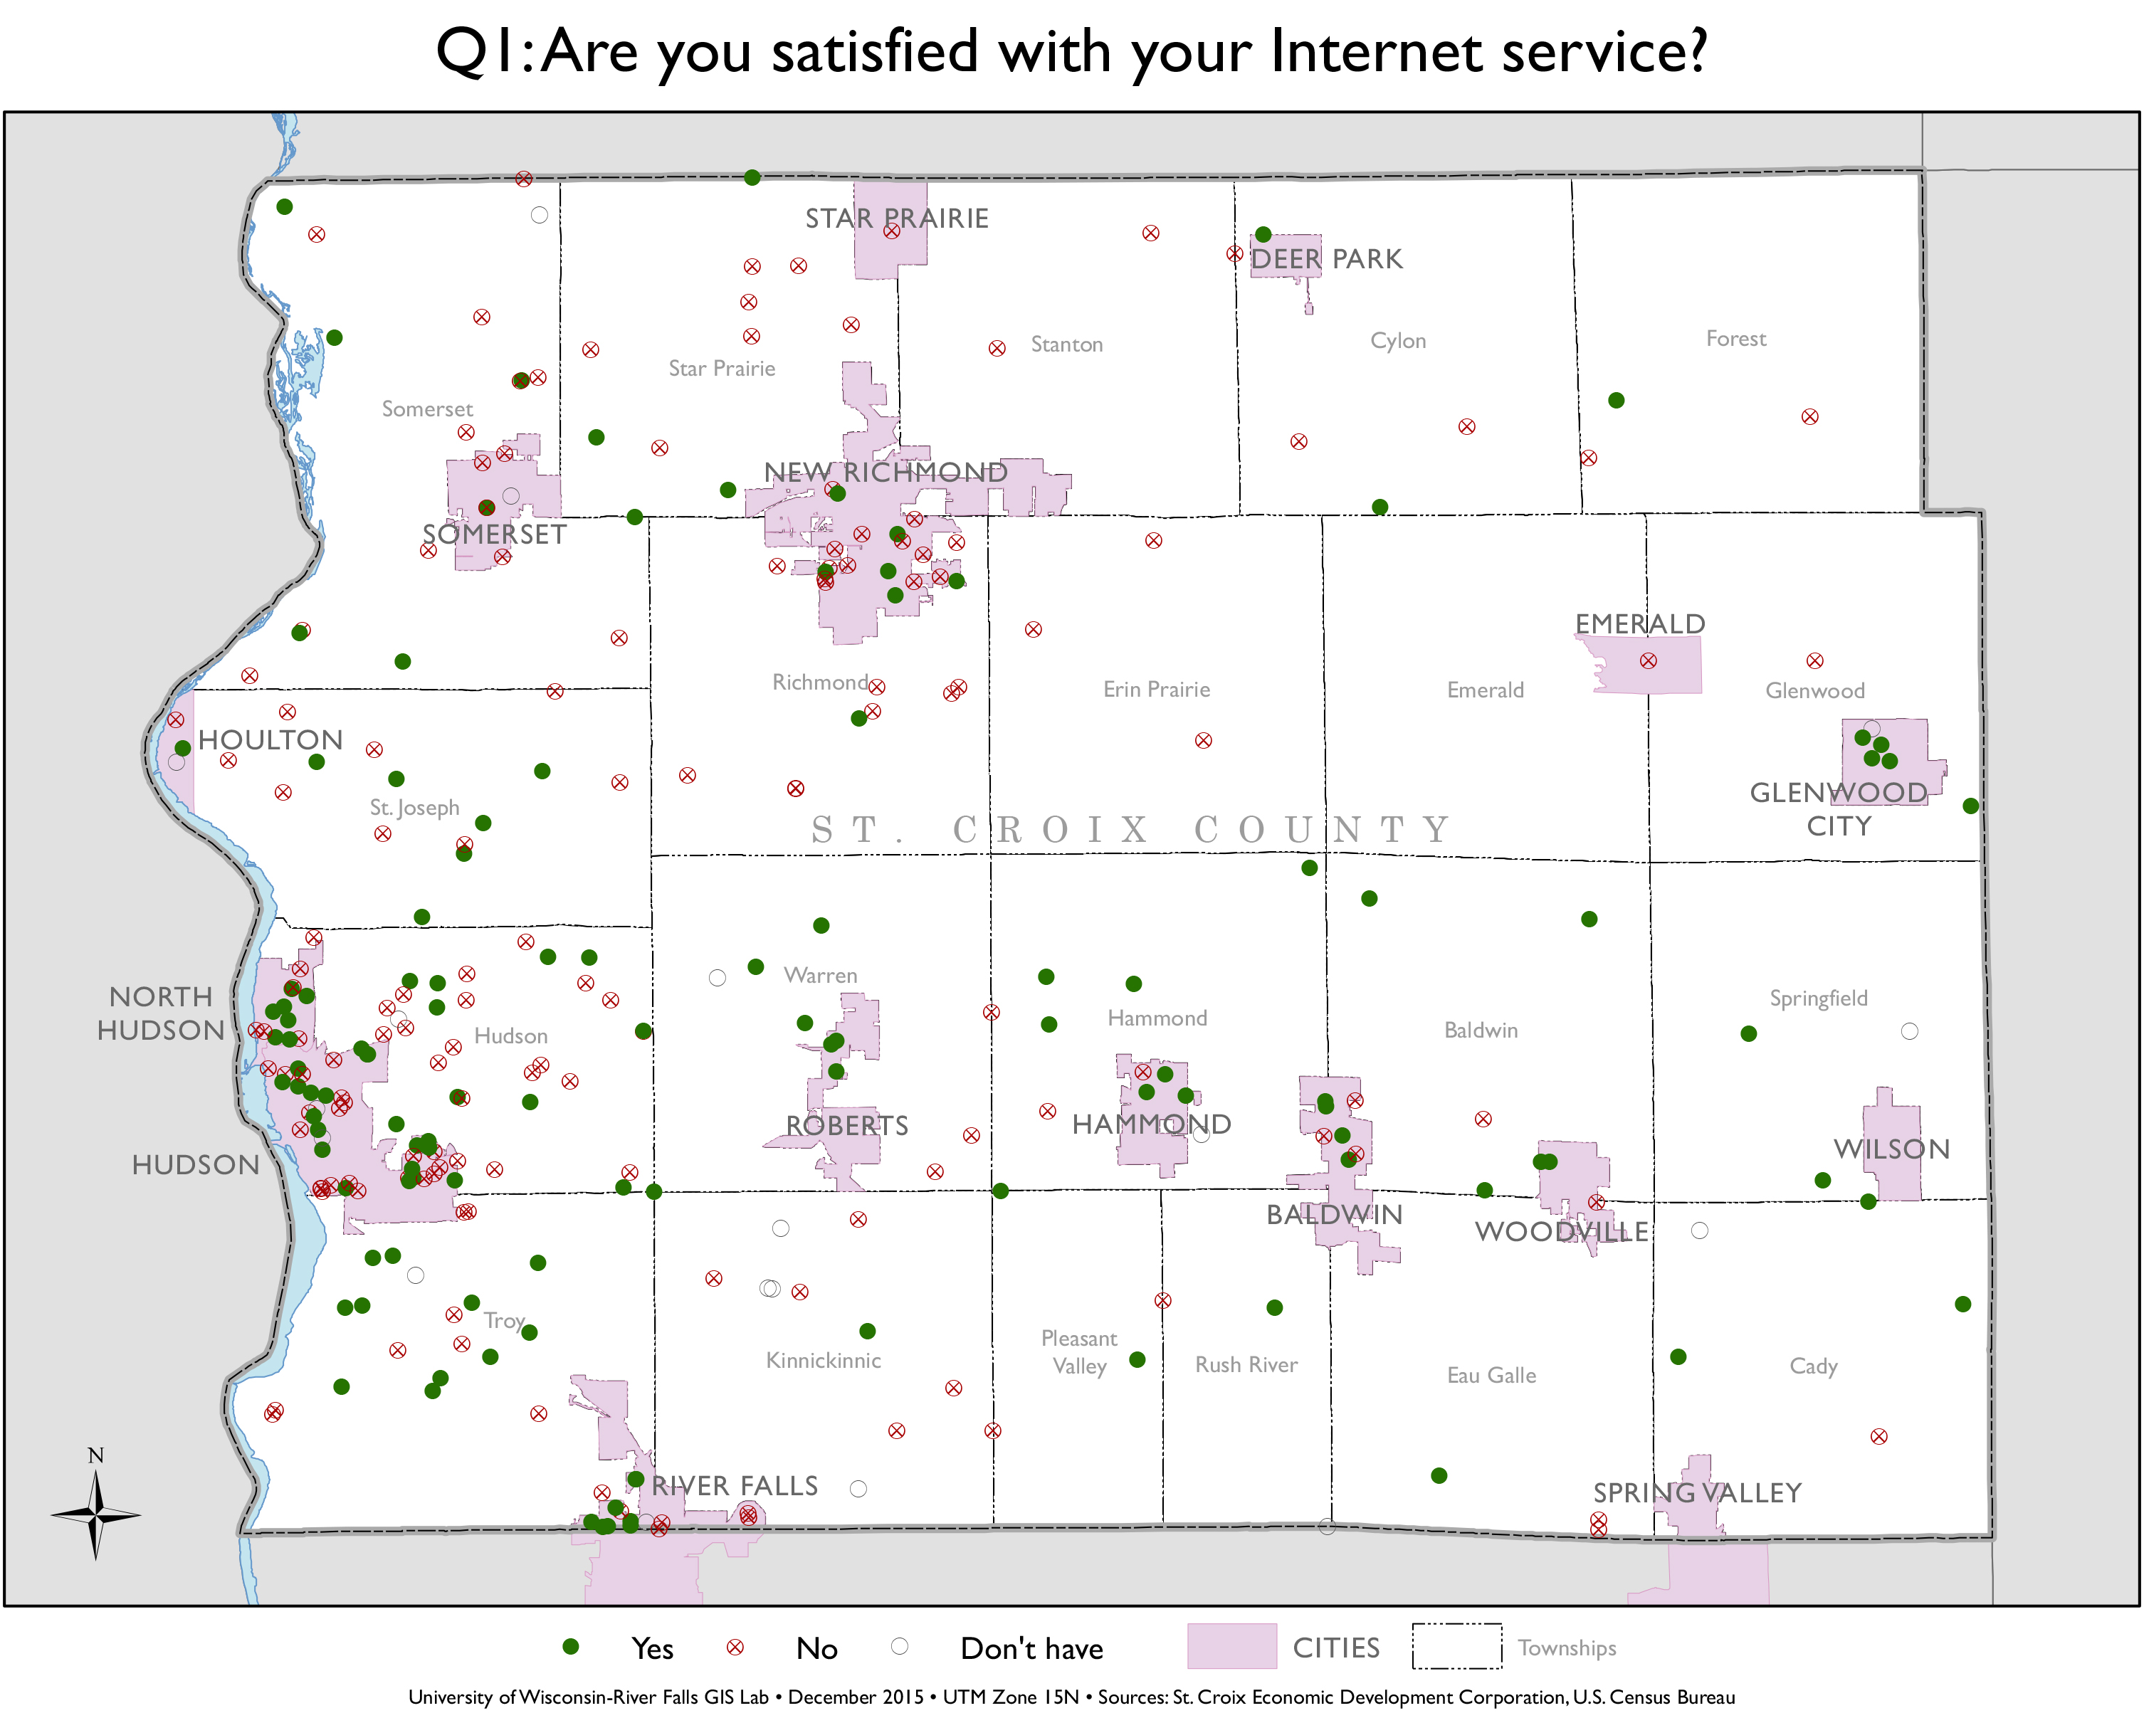
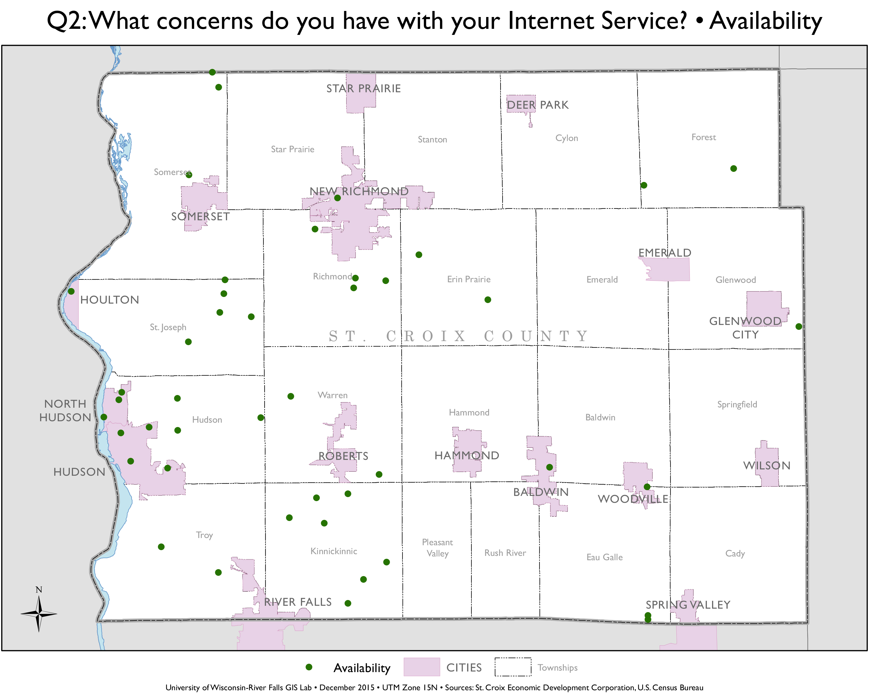
Phase 1 Survey Results

Slide 23
Phase 1 Survey Results

Slide 25
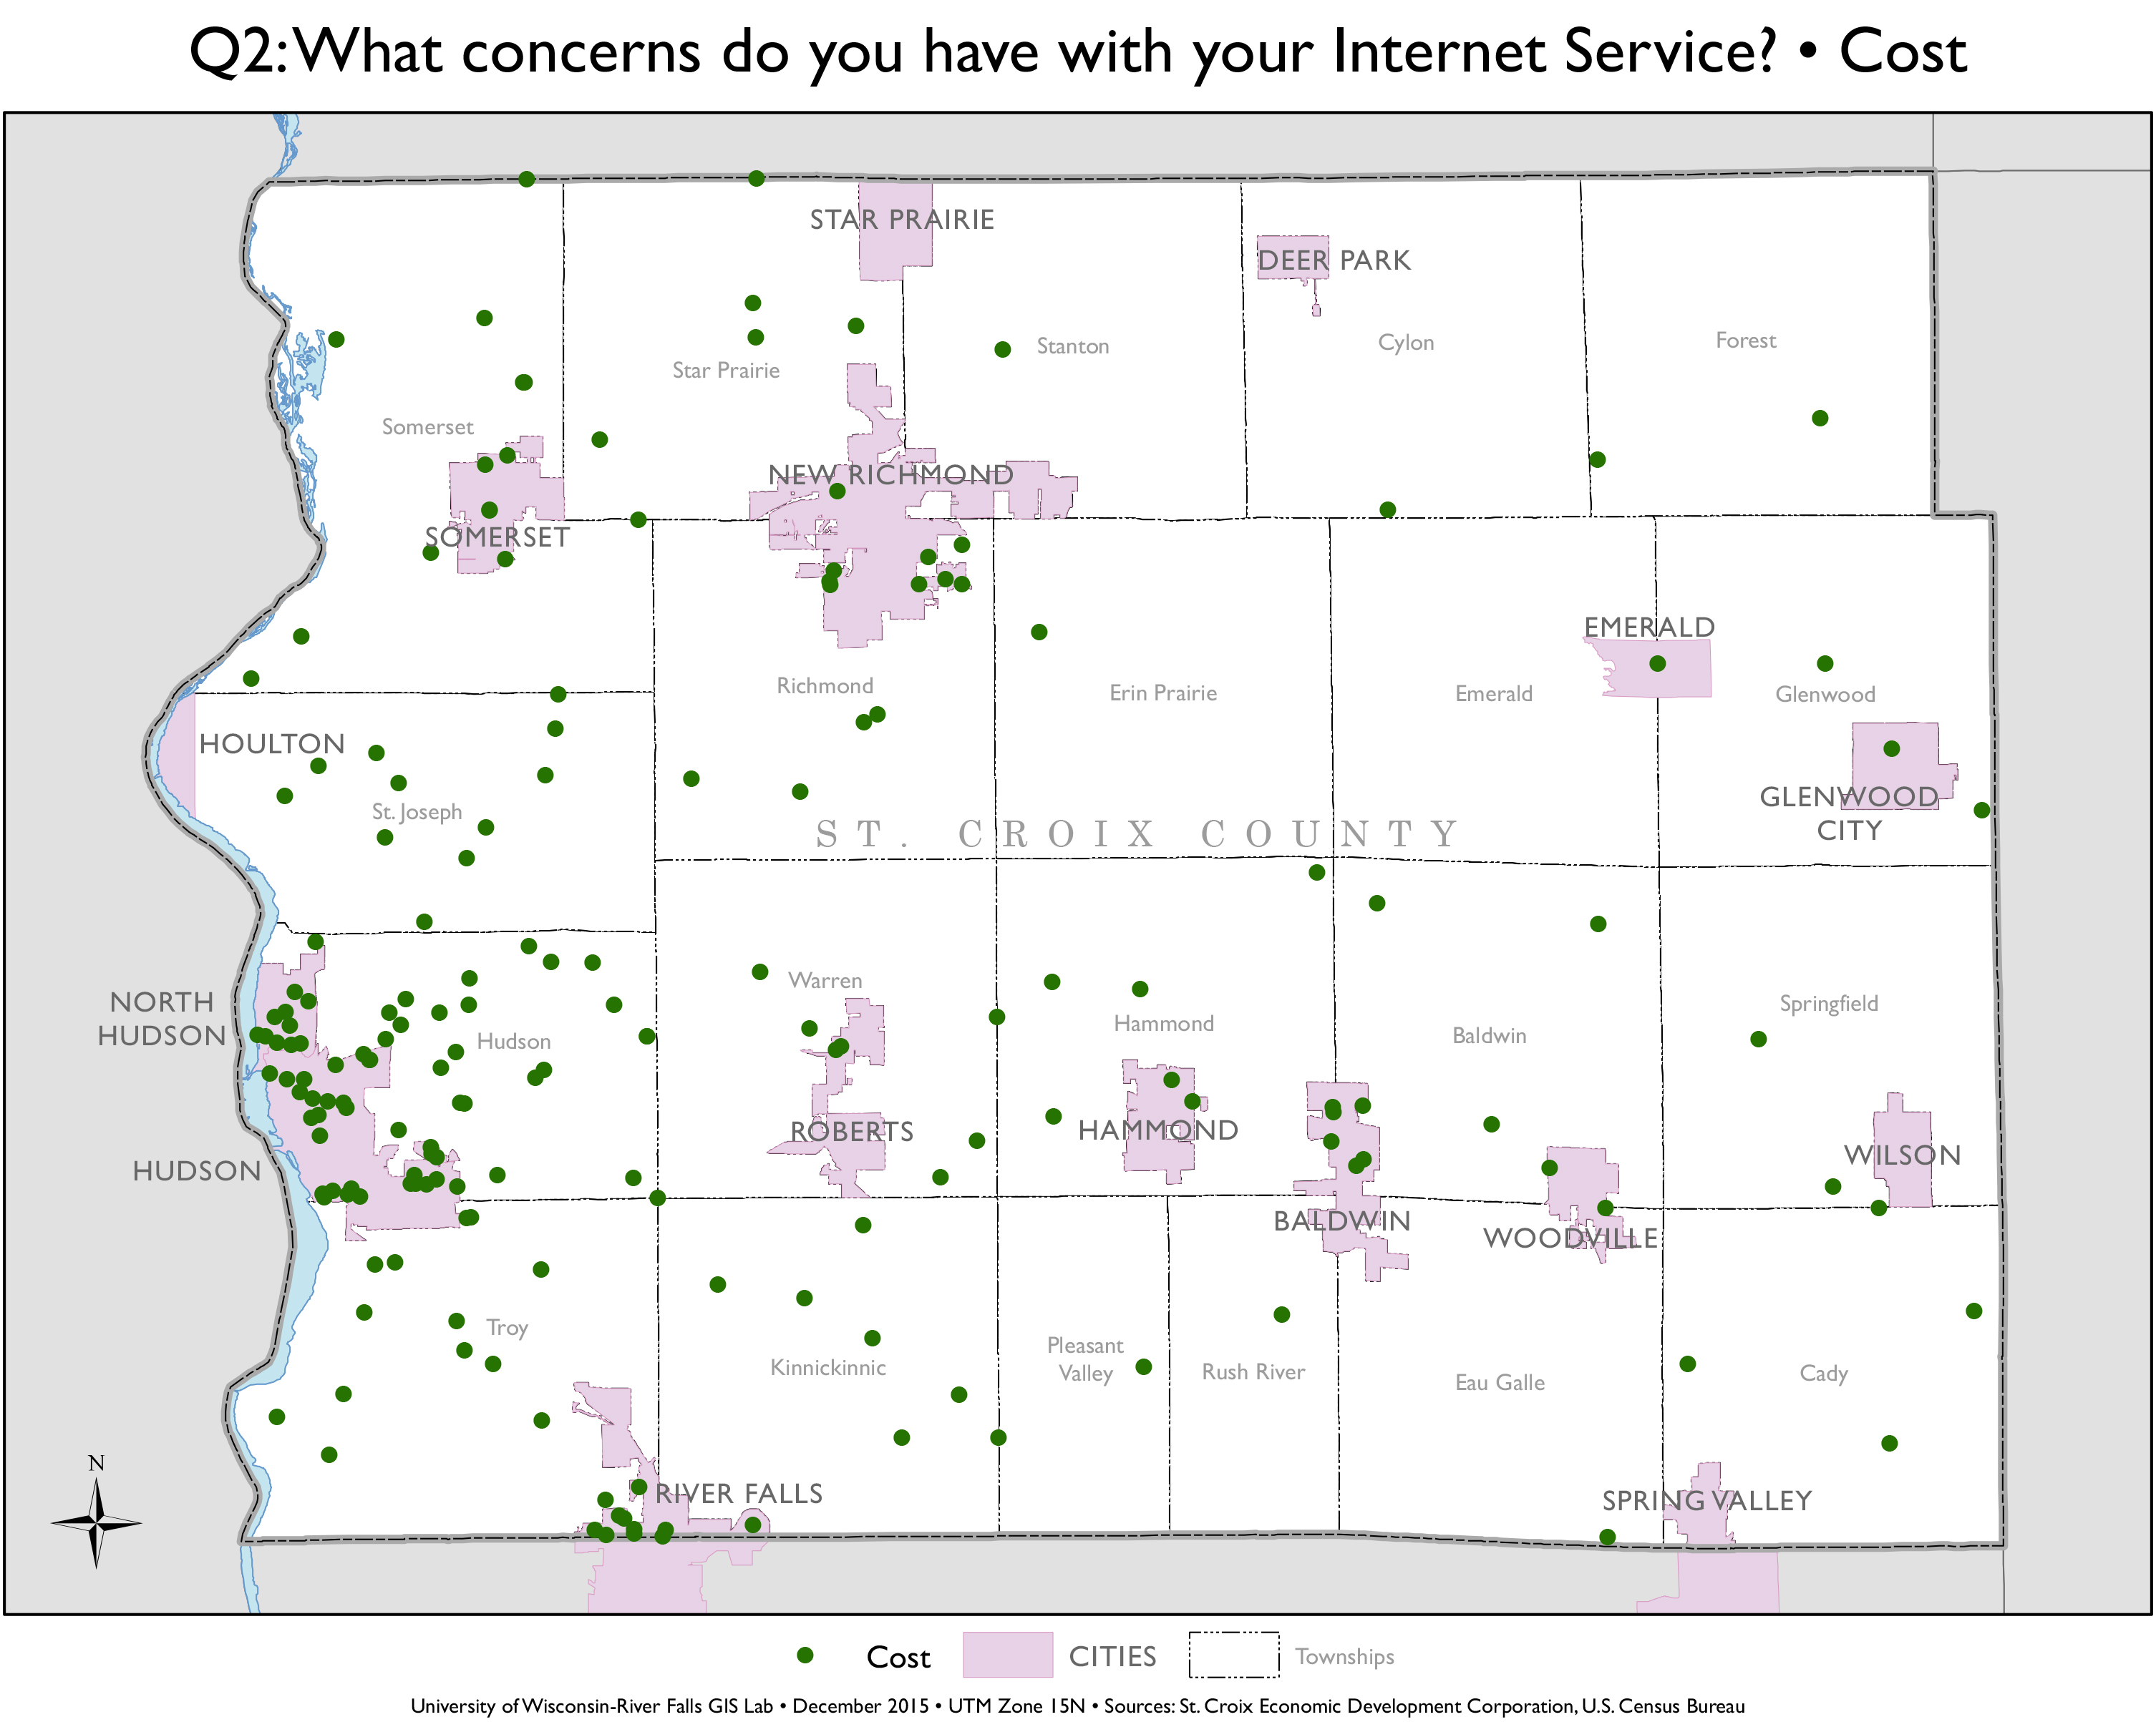

Slide 27
Next Steps: Phase 2 Survey
Drafting a phase 2 survey now
Having meetings/presentations to inform and gather more information
Work with Survey Research Center to help determine best area(s) of focus
Implement phase 2 survey and analyze

Slide 28
What can local governments do?
Framework for Change
Creating a sense of urgency
Building a guiding coalition
Developing and communicating a strategic vision
Enabling action and removing barriers
Generating short-term wins
Learning from experience and instituting change

Slide 29
What can local governments do?
Creating a Sense of Urgency:
Broadband Resolutions: Support broadband development either internally or in support of another organization. Affirms desire for broadband development and builds momentum toward more substantial action.
Community Surveys: Measure perception, current use, and demand for broadband. Can provide important information for grant applications.

Slide 30
What can local governments do?
Building a Guiding Coalition:
Technology Committees: Performs research and advises decision makers on maters of technology, including broadband. Help guide community action toward broadband.
Developing and Communicating a Strategic Vision
Broadband Inclusive Comprehensive Planning: Includes broadband in comprehensive plans, often addressed in the utilities and community facilities section. Can include state of local utilities description, list of providers, documented demand, and goals for broadband availability or access.
Broadband Specific Planning: Separate plan that addressed broadband and broadband development

Slide 31
What can local governments do?
Enabling Action and Removing Barriers
Local ordinances and codes: local governments may use ordinances, permits, and zoning codes to strategically improve broadband access
Public Rights-of-Way Policies: local government have discretion in process including authority to waive fees and expedite application processes.
Dig-Once Ordinances: Require that any entity planning construction on public rights-of-way also allow installation of conduit, fiber, or other broadband infrastructure as part of the construction. The owner of the right-of-way is generally responsible for informing private ISPs of the opportunity.
Tower Ordinances: Modification of existing towers and co-location of equipment owned by separate entities on a single tower

Slide 32
What can local governments do?
Enabling Action and Removing Barriers
Public Private Partnerships: (e.g. local gov’t and ISPs; normally for individual projects.)
Tower Agreements: Local governments have authority to enter into agreements with private ISPs allowing them to construct or install wireless telecommunications infrastructure on publically owned towers and land.
Shared Resource Agreements: Local governments and public departments agree to share resources for example, local government may waive portions of permission process and grant right-of-way to private entity; in exchange, private entity will install fiber or other infrastructure in right-of-way in addition to other planned construction.
Partnerships for Funding a Co-Application: Partners may offer construction services, matching funds, in-kind contributions, outreach efforts, supporting resolutions, or other contributions. Can strengthen an application and increase chances of receiving funding (e.g. required by PSC Expansion Grants).

Slide 33
What can local governments do?
Generating Short-term Wins
Broadband Adoption
Digital Literacy
Telecommuting and Telehealth
Broadband Expositions: Bring together local providers, institutions, business owners, and individuals that might benefit from adoption.

Slide 34
What can local governments do?
Learning from Experience/Instituting Change
Private Provider Investment:
Public-Private Partnerships:
Cooperatives: group organized democratically and controlled by its members for a particular economic function. Exist to meet needs of its members.
Community Area Networks: Organized by local groups to support needs of community anchor institutions. Members collaborate and share resources to maximize functionality of the network.
Local Government Telecommunications Alternatives: Local governments construct their own broadband infrastructure for either internal use or to provide services directly or indirectly to their community.

Slide 35
Thank you!
Eric Biltonen, Ph.D.
Community, Natural Resources, and Economic Development Educator
UW Extension, St. Croix County
E-mail: eric.biltonen@ces.uwex.edu
Recommendations on LinkedIn are greatly appreciated!

Slide 36
References
Source: Ericsson, Arthur D. Little, and Chalmers University of Technology, 2013, Socioeconomic Effects of Broadband Speed
Source: Igonzalez, April 2015, FTTH Adding Value to Apartments and Condos, Studies Show
Molnar, Savage, and Sicker, 2015, Reevaluating the Broadband Bonus: Evidence from Neighborhood Access to Fiber and United States Housing Prices
Knutson, Ryan (2015) How Fast Internet Affects Home Prices, Wall Street Journal
Wisconsin Technology Council (2011), Connecting Rural Wisconsin: The Economic Necessity of Broadband
McKinsey Global Institute (2015) A Labor Market the Works: Connecting Talent with Opportunity in the Digital Age
Heger, Rinawi, and Veith, The effect of Broadband Infrastructure on Entrepreneurial Activities: The Case of Germany
Strategic Networks Group, Inc. (2014) The Return from Investment in Broadband Infrastructure and Utilization Initiatives, Blandin Foundation
Kongaut, Rohman, and Bohlin (2014) The Economic Impact of Broadband Speed: Comparing between Higher and Lower Income Countries

